Slide 1

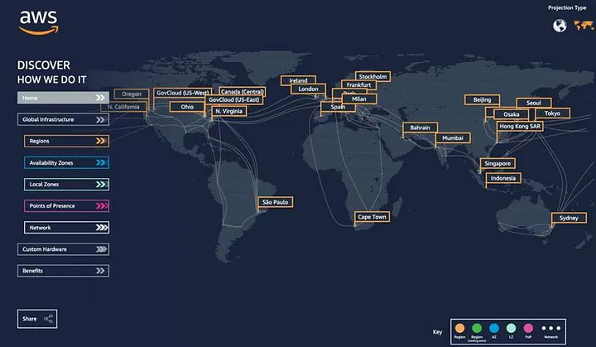
AWS Global Infrastructure
Unlimited Powerful Learning
AWS Regions :
AWS divides the world into geographic regions. Each region is a separate geographic area with multiple data centers, also known as Availability Zones (AZs).
AWS has 32 regions worldwide, and they continue to expand.

Slide 2
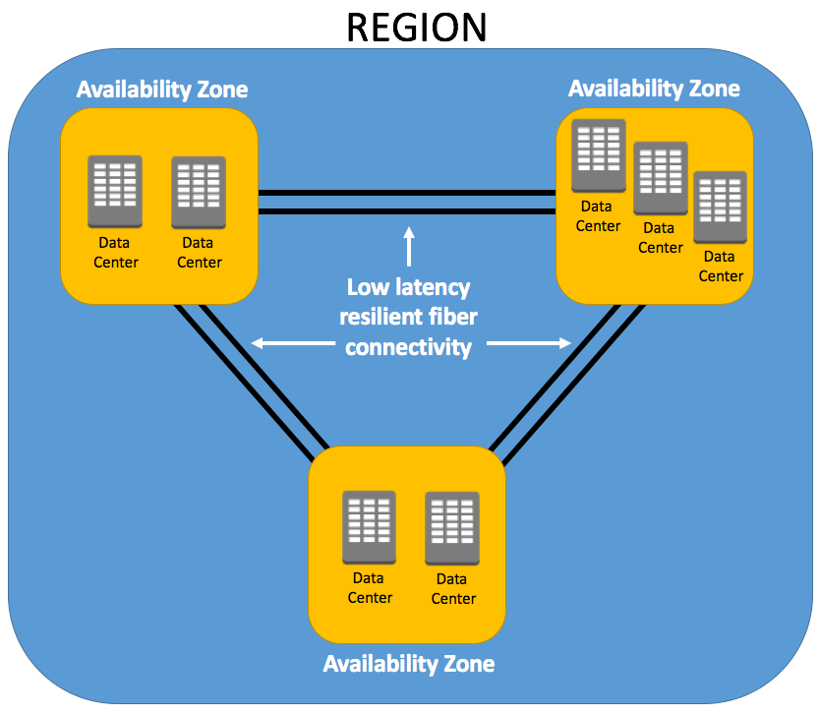
AWS Global Infrastructure
Unlimited Powerful Learning
AWS Availability zones (AZs) :
Within each region, there are multiple Availability Zones (usually three or more).
These AZs are isolated data centers with redundant power, cooling, and networking to ensure high availability and fault tolerance.
They are interconnected with low-latency links.

Slide 3
AWS Global Infrastructure
Unlimited Powerful Learning
Edge locations :
In addition to regions and AZs, AWS has a network of Edge Locations.
These are distributed points of presence (PoPs) around the world that are used for content delivery and other edge computing tasks.
AWS services like Amazon CloudFront (a Content Delivery Network or CDN) use these locations to cache and deliver content closer to end-users.

Slide 4
AWS IAM
Unlimited Powerful Learning
Users :
IAM allows you to create and manage user accounts for people, systems, or applications that need access to your AWS resources. Each user has a unique set of security credentials (username and password) or can use their AWS Identity Federation credentials to access AWS.
Groups :
Users can be organized into groups, simplifying permissions management. Instead of assigning permissions individually to each user, you can attach policies to groups, and users within the group inherit those permissions.
Roles :
IAM policies define permissions. They are JSON documents that specify what actions are allowed or denied on AWS resources. You can attach policies to users, groups, and roles. AWS provides managed policies that cover common use cases, and you can also create custom policies.

Slide 5
AWS IAM
Unlimited Powerful Learning
Policies :
IAM policies define permissions. They are JSON documents that specify what actions are allowed or denied on AWS resources. You can attach policies to users, groups, and roles. AWS provides managed policies that cover common use cases, and you can also create custom policies.
Permission Boundaries :
Permission boundaries are an advanced IAM feature that allows you to delegate permissions management while maintaining control over what can be delegated. They set the maximum permissions a user or group can have
Multi-Factor Authentication (MFA) :
You can enable MFA for IAM users, adding an additional layer of security. MFA requires users to provide a time-based one-time password (TOTP) in addition to their password when signing in.

Slide 6
AWS IAM
Unlimited Powerful Learning
Policies :
IAM policies define permissions. They are JSON documents that specify what actions are allowed or denied on AWS resources. You can attach policies to users, groups, and roles. AWS provides managed policies that cover common use cases, and you can also create custom policies.
Permission Boundaries :
Permission boundaries are an advanced IAM feature that allows you to delegate permissions management while maintaining control over what can be delegated. They set the maximum permissions a user or group can have
Multi-Factor Authentication (MFA) :
You can enable MFA for IAM users, adding an additional layer of security. MFA requires users to provide a time-based one-time password (TOTP) in addition to their password when signing in.

Slide 7
AWS IAM
Unlimited Powerful Learning
Identity Federation :
IAM supports identity federation, allowing you to grant temporary, limited access to your AWS resources to users authenticated through external identity providers, such as Active Directory, LDAP, or social identity providers like Google or Facebook.
Access Analyzer :
This IAM feature helps you identify and review the resources within your organization and provides automated findings for public and cross-account access, helping you adhere to security best practices.
Resource-Based Policies :
In addition to user and group-based policies, some AWS resources (e.g., S3 buckets) have their own policies that control who can access them. These are called resource-based policies.
IAM Access Advisor :
This tool provides insights into how permissions are being used within your AWS account, helping you adjust policies to ensure the principle of least privilege.

Slide 8
AWS Console and Cli
Unlimited Powerful Learning
AWS Management Console :
The AWS Management Console is a web-based interface that provides a graphical user interface (GUI) for managing AWS resources and services. It is designed to be user-friendly and is particularly useful for users who may not be comfortable with command-line interfaces or scripting.
Key features of the AWS Management Console include the ability to create, configure, and manage AWS resources such as EC2 instances, S3 buckets, RDS databases, and more through a point-and-click interface.
It provides a visual representation of your AWS environment and allows you to view and manage resources in a hierarchical manner.

Slide 9
AWS Console and Cli
Unlimited Powerful Learning
AWS Command Line Interface (CLI):
The AWS CLI is a command-line tool provided by AWS that allows users to interact with AWS services and resources using text-based commands. It provides a programmatic way to manage and automate AWS tasks.
The AWS CLI is particularly useful for automating repetitive tasks, scripting, and integrating AWS operations into your own scripts or applications.
It is available for Windows, macOS, and Linux, and it can be installed and configured to work with your AWS account credentials.

Slide 10
AWS Security
Unlimited Powerful Learning
Amazon Web Services (AWS) provides a robust and secure cloud computing platform, but ensuring the security of your AWS resources and data is a shared responsibility between AWS and its customers.
Use the AWS Identity and Access Management (IAM) Service :
Implement the principle of least privilege by granting users and applications only the permissions they need.
Regularly review and audit IAM permissions to ensure they align with your organization's policies.
Multi-Factor Authentication (MFA):
Enable MFA for all AWS IAM users to add an extra layer of security.
Secure Your AWS Root Account:
Secure your AWS root account with a strong password and enable MFA.
Encryption :
Encrypt data at rest using AWS Key Management Service (KMS) and server-side encryption (SSE).
Encrypt data in transit using HTTPS and other secure protocols.

Slide 11
AWS Security
Unlimited Powerful Learning
Network Security :
Use Amazon Virtual Private Cloud (VPC) to isolate your resources and control network traffic.
Implement security groups and Network ACLs to control inbound and outbound traffic.
Consider using AWS WAF (Web Application Firewall) to protect against web application attacks.
Use AWS Security Hub to centralize and automate security compliance checks.
Logging and Monitoring :
Enable AWS CloudTrail to log all API calls made on your AWS account.
Use Amazon CloudWatch to monitor AWS resources and set up alarms for suspicious activity.
Implement centralized logging with services like Amazon CloudWatch Logs or AWS Elasticsearch.
Patch Management :
Keep your EC2 instances and other AWS resources up to date with the latest security patches.
Use Amazon Inspector for automated security assessments of your EC2 instances.

Slide 12
AWS Security
Unlimited Powerful Learning
Data Backups and Disaster Recovery:
Implement regular backups and test your disaster recovery plan.
Use AWS services like Amazon S3 for data storage and Glacier for long-term archival.
Secure API Gateway:
Use AWS API Gateway to securely expose your APIs and enable features like authentication and authorization.
Security Groups and NACLs:
Use security groups and Network ACLs to control traffic at the network and instance level.
Use AWS Trusted Advisor:
AWS Trusted Advisor provides security checks and recommendations for cost optimization, performance improvement, and security.
Data Classification and Access Control:
Classify your data based on sensitivity and implement appropriate access controls.
Use AWS services like AWS Secrets Manager and AWS Certificate Manager to manage sensitive data.

Slide 13
AWS Security
Unlimited Powerful Learning
Incident Response Plan:
Develop an incident response plan to address security incidents promptly and effectively.
Regular Security Audits and Penetration Testing:
Conduct regular security audits and penetration testing to identify vulnerabilities and weaknesses in your AWS environment.
Training and Awareness:
Ensure that your team is trained on AWS security best practices and remains aware of the evolving threat landscape.
Compliance:
If your organization needs to meet specific compliance requirements (e.g., HIPAA, PCI DSS), ensure that your AWS environment aligns with those standards.
AWS Security Services:
Leverage AWS security services like AWS GuardDuty for threat detection, AWS Inspector for vulnerability assessments, and AWS Config for resource tracking and compliance.
Data Loss Prevention (DLP):
Implement DLP solutions and policies to prevent sensitive data from leaving your AWS environment unintentionally.
Serverless Security:
If you use serverless computing with AWS Lambda, ensure you follow best practices for securing serverless applications.

Slide 14
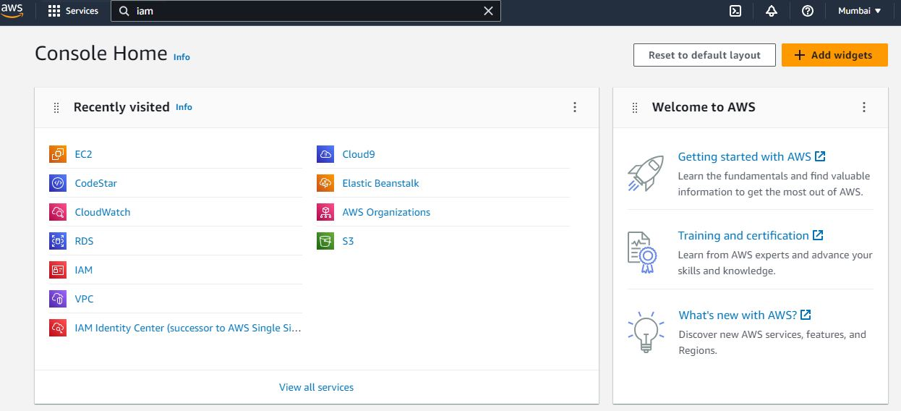
Lab
Unlimited Powerful Learning
Step 1 :
login to your aws console and type iam in search bar

Slide 15
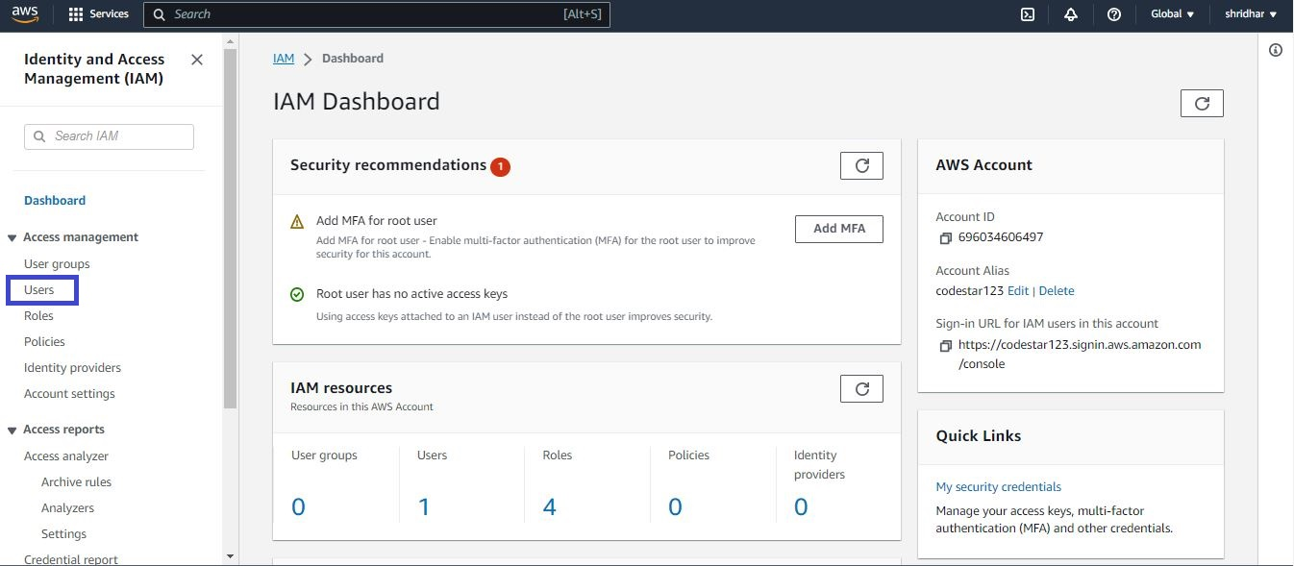
Lab
Unlimited Powerful Learning
Step 2 :
click on user as shown below

Slide 16
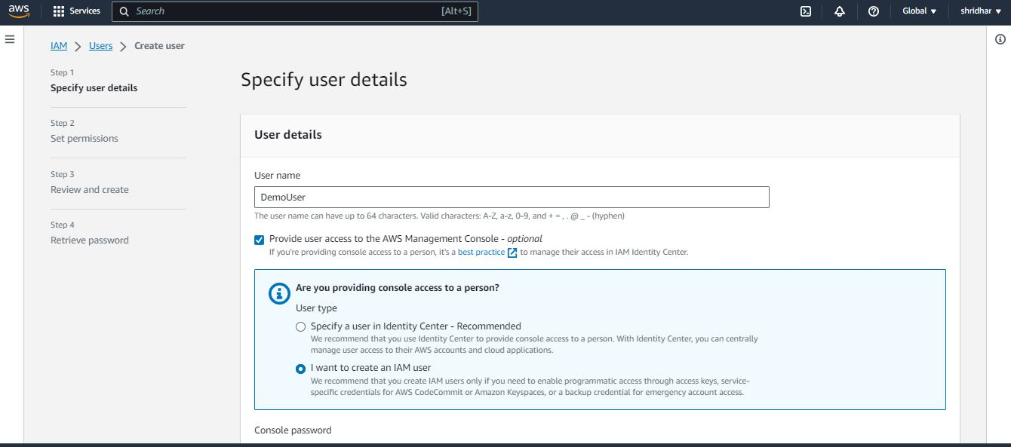
Lab
Unlimited Powerful Learning
Step 3 :
Next type your username and check on provide user access to aws management console.
check on create an Iam user.

Slide 17
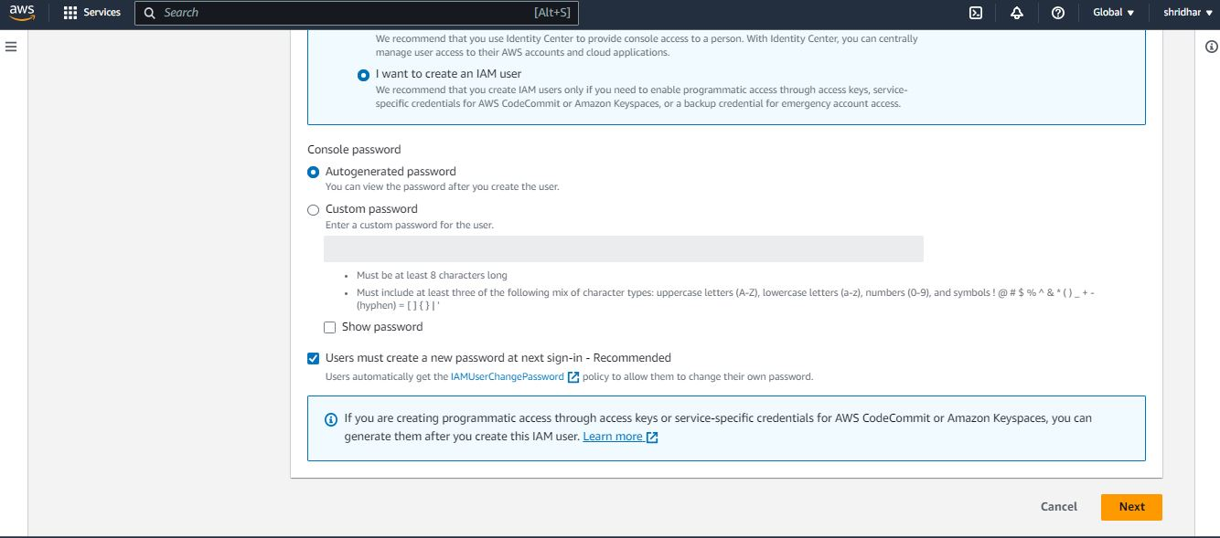
Lab
Unlimited Powerful Learning
Step 4 :
in console password section choose the option you need and type next.

Slide 18
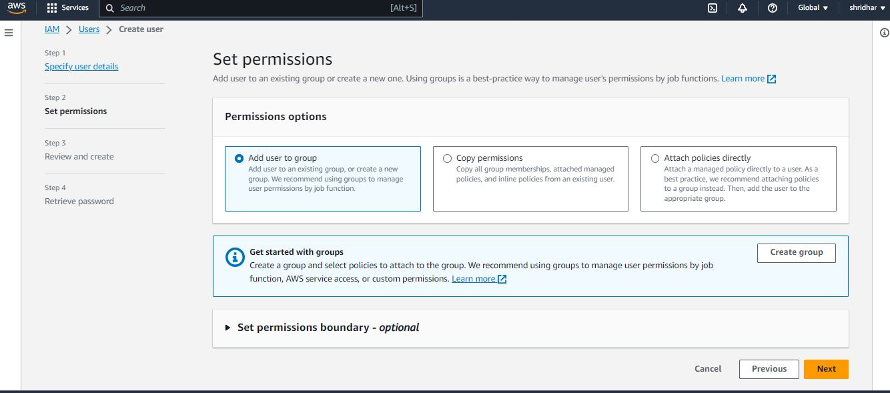
Lab
Unlimited Powerful Learning
Step 5 :
next set permissions, you can choose any option of your choice here we are selecting Add user to group and create new group by selecting create group option

Slide 19
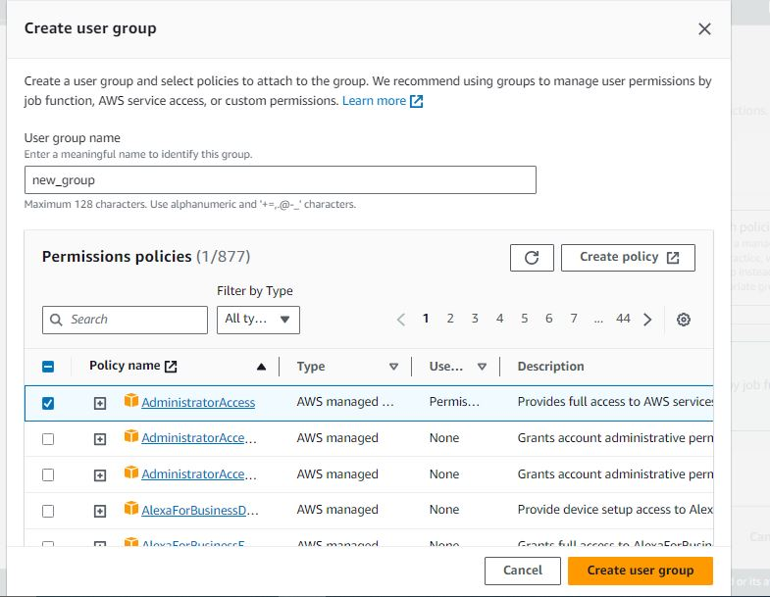
Lab
Unlimited Powerful Learning
Step 6 :
in create user group, type the group name and attach iam policies to the group so as to give our group certain permissions to carry out task in aws
here we are attaching Administrator access to the group.
click next.

Slide 20
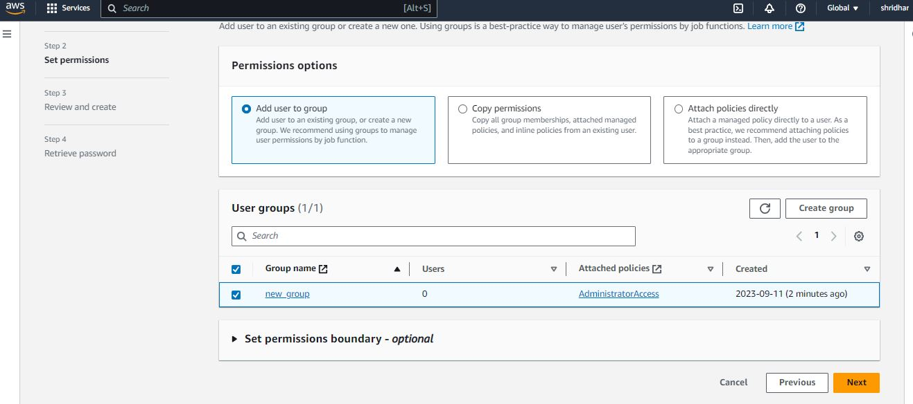
Lab
Unlimited Powerful Learning
Step 7 :
add user to newly created group by checking box as shown below and click next

Slide 21
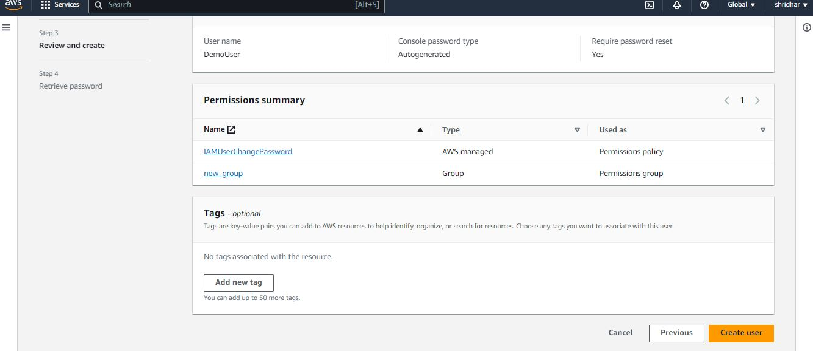
Lab
Unlimited Powerful Learning
Step 8 :
Review and create the new use by clicking on create user option as shown below

Slide 22
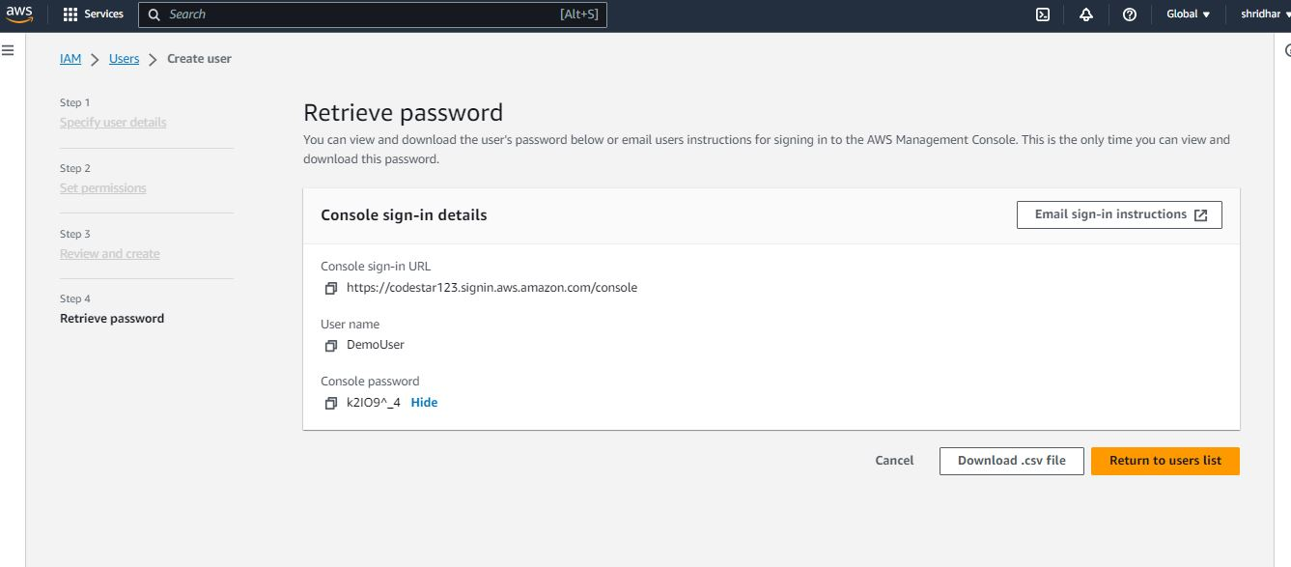
Lab
Unlimited Powerful Learning
Step 10 :
copy the newly created password for the user and click on return to user list option.

Slide 23
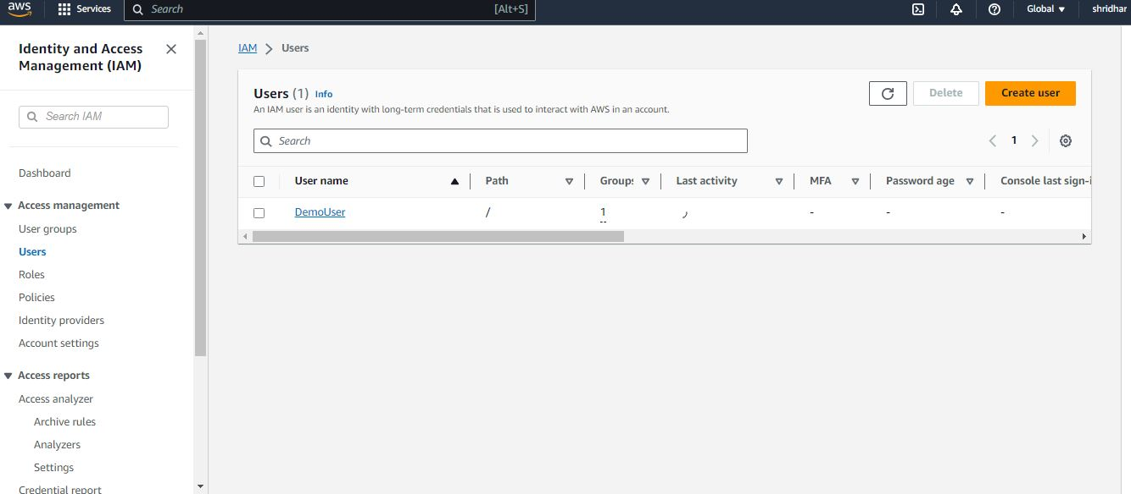
Lab
Unlimited Powerful Learning
Step 10 :
As you can see new user has been created in the name of DemoUser.

Slide 24
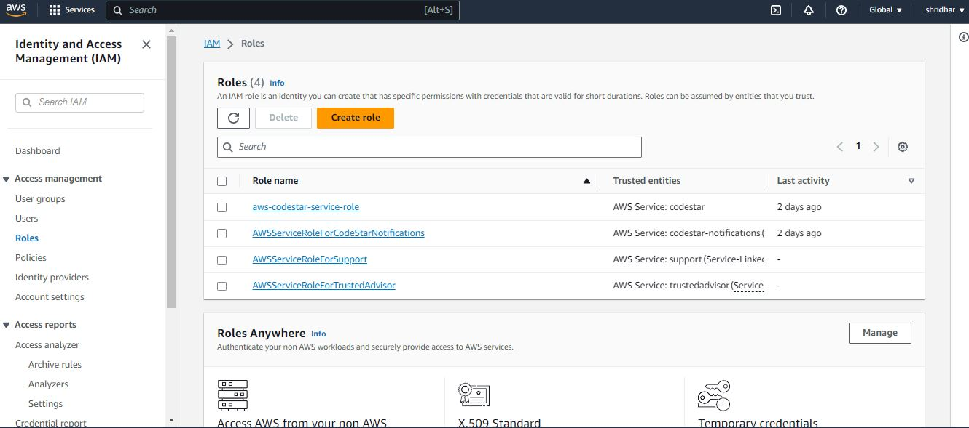
Lab
Unlimited Powerful Learning
Roles
Choose roles option and click on create role

Slide 25
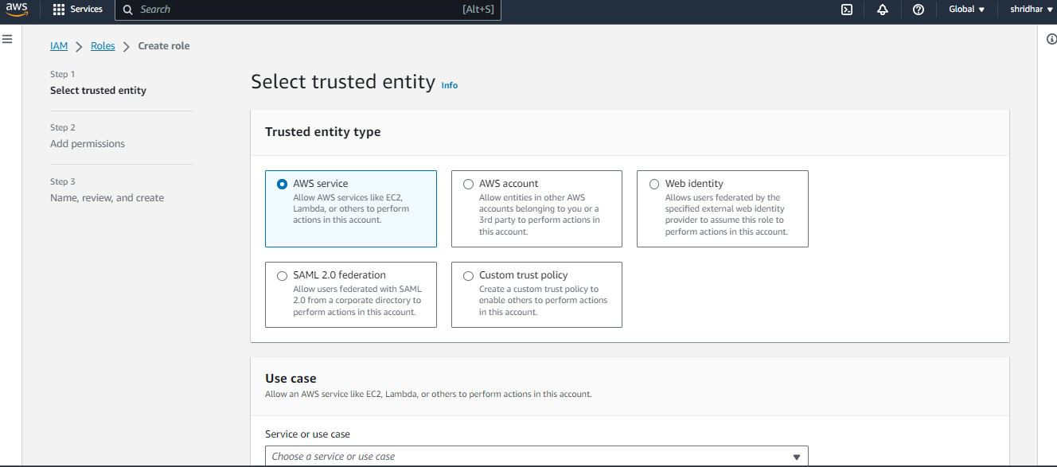
Lab
Unlimited Powerful Learning
Step 2 :
select trusted entity, we are selecting aws services

Slide 26
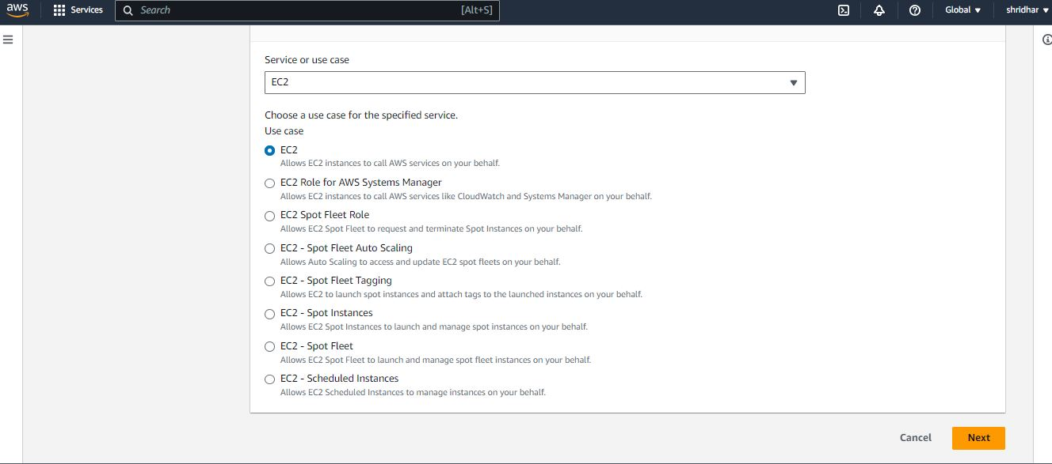
Lab
Unlimited Powerful Learning
Step 3 :
select the service you want to attach the role to, here we are selecting ec2 and click next.

Slide 27
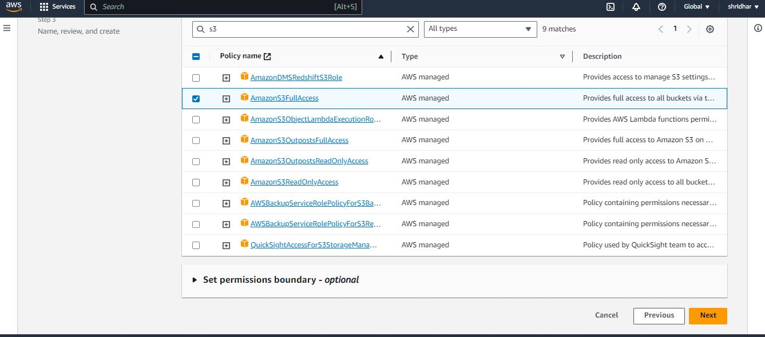
Lab
Unlimited Powerful Learning
Step 4 :
next select the policy that you want to attach to the role, we are selecting Amazons3FullAccess
click next

Slide 28
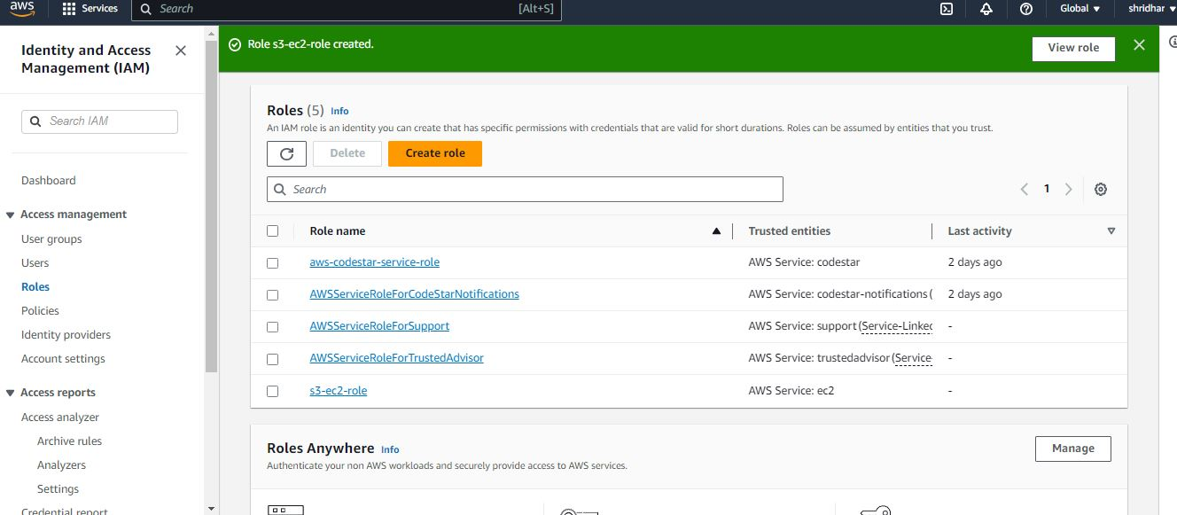
Lab
Unlimited Powerful Learning
Step 4 :
as you can see the new role has been created.

Slide 29
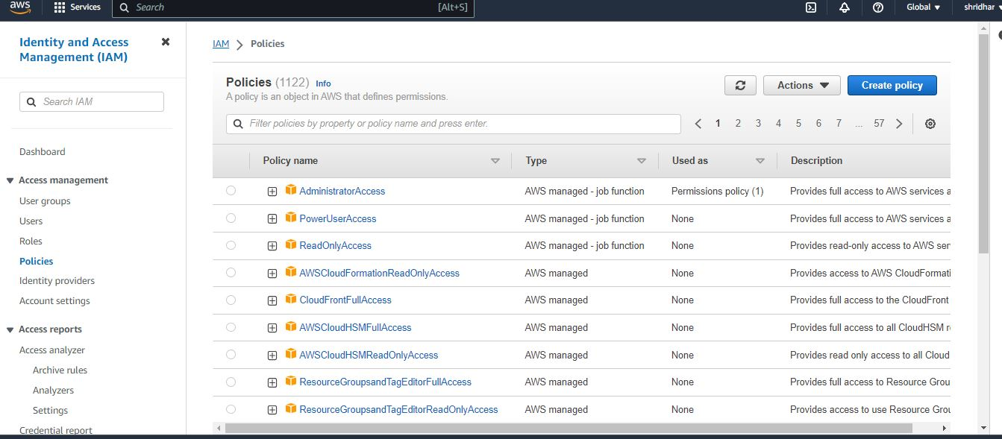
Lab
Unlimited Powerful Learning
Policies :
create new policy by clicking on policies option and selectin create policy option.

Slide 30
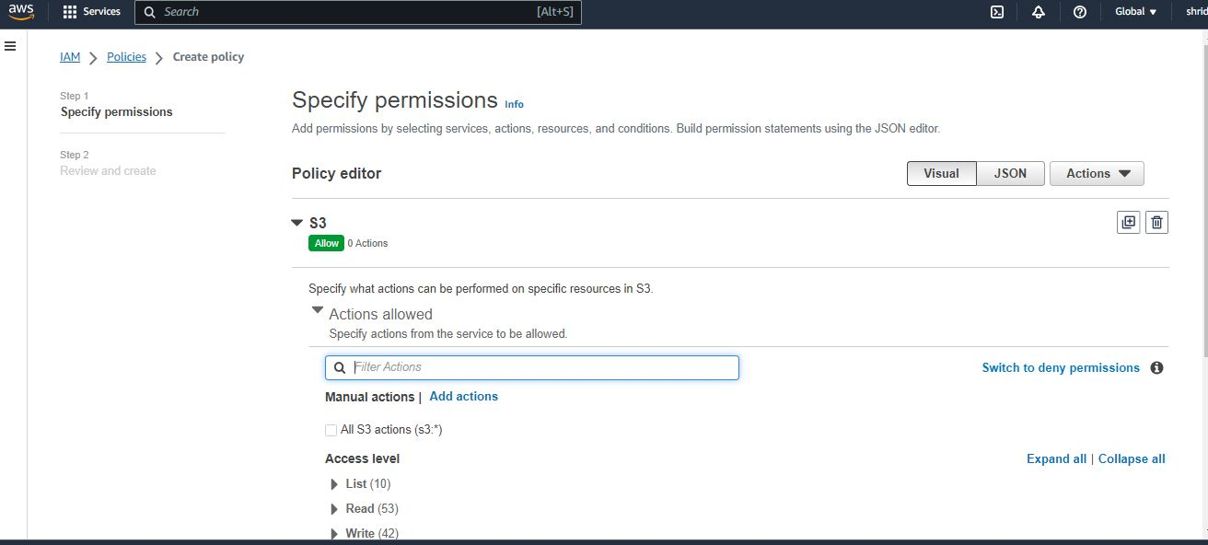
Lab
Unlimited Powerful Learning
Step 2:
specify the type of policy you want to create we are creating s3 bucket policy.

Slide 31
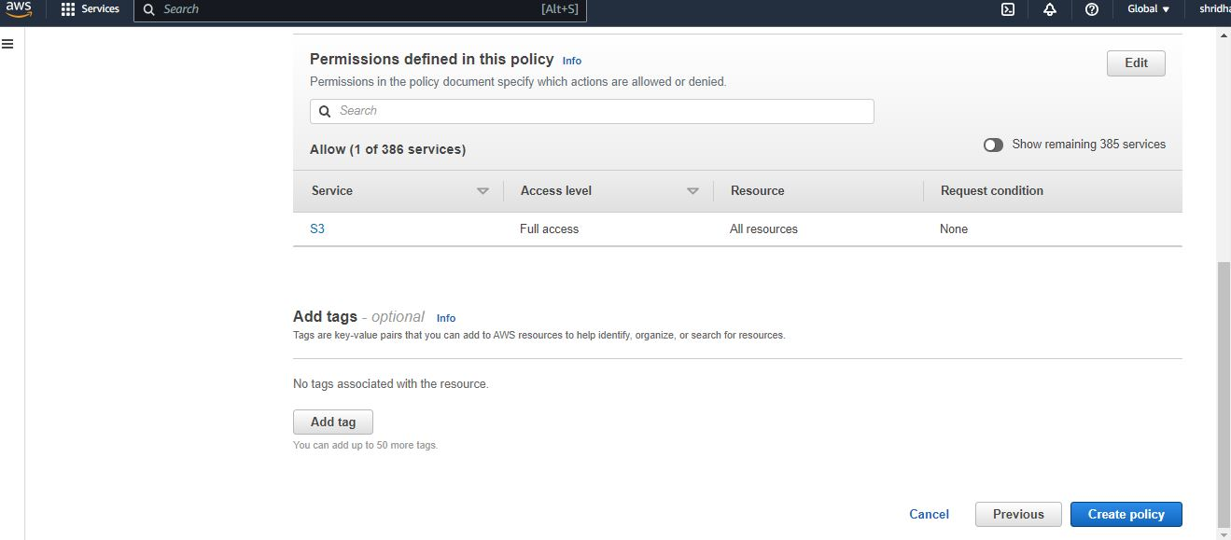
Lab
Unlimited Powerful Learning
Step 3:
Review and create policy.

Slide 32
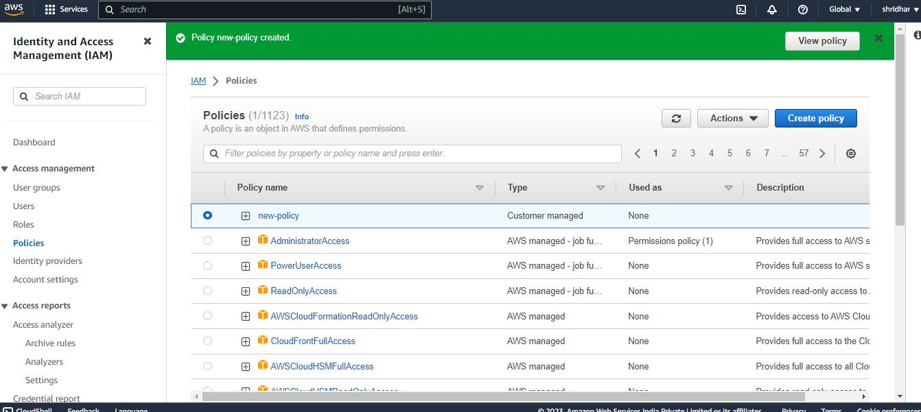
Lab
Unlimited Powerful Learning
Step 4 :
As you can see new policy has been created with the name new-policy.

